Slide 1
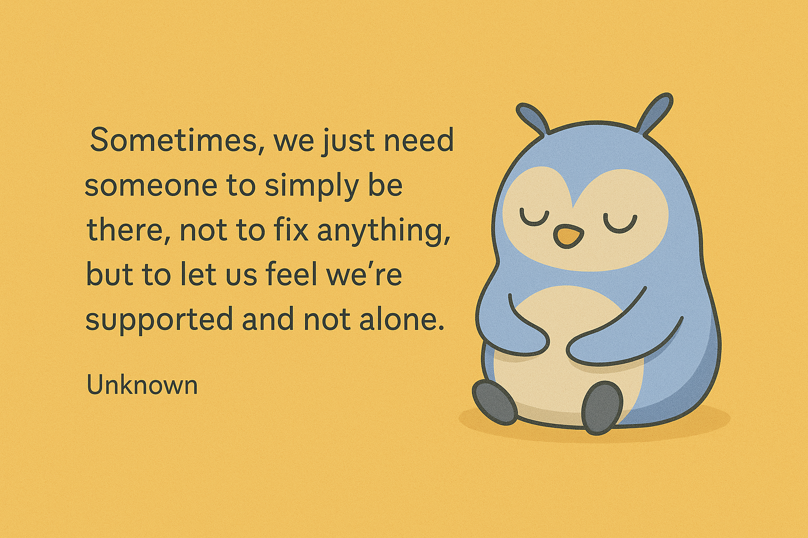

Slide 2
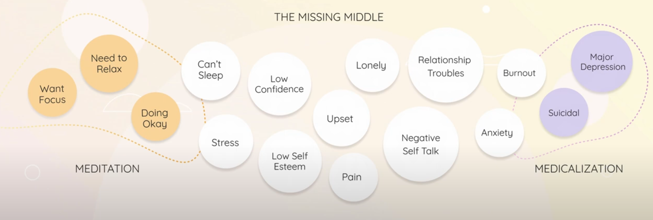
Mental Health Crisis:
The Need for Accessible Support

Slide 3

Healing Through Conversation: A New Era of Self-Care
How Wysa is transforming mental health through
cognitive computing?
In a world that never stops moving, what happens
when your mind needs a pause?
Presented by
Smarth Kaushal (102497023) and Rhumeet Bhatia (102317171)

Slide 4
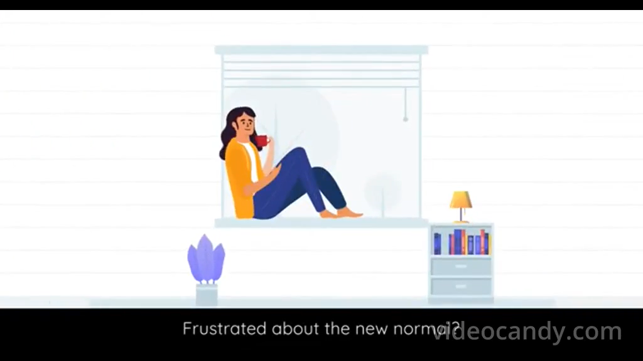

Slide 5
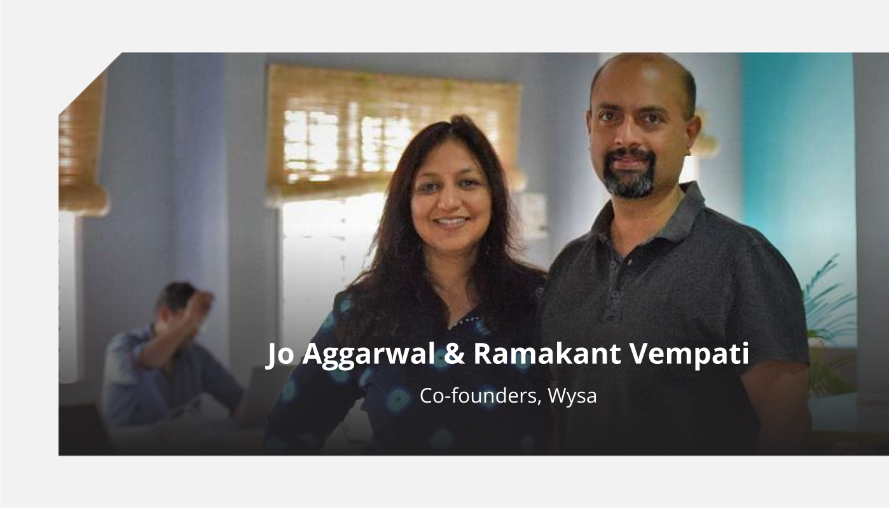

Slide 6





An AI That Listens, Learns, and Supports
CBT & DBT techniques
NLP-based recognition
Evidence-based therapies
Understands emotional context
Journaling, tracking
Mindfulness prompts
Records emotional patterns
Guides through difficult moments

Slide 7
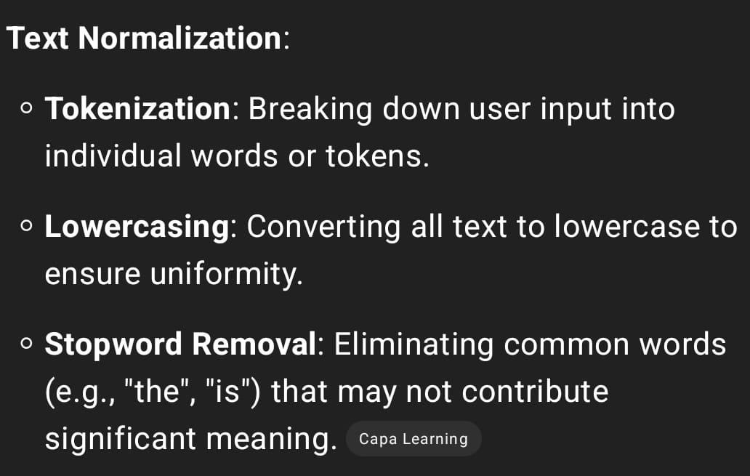

Slide 8
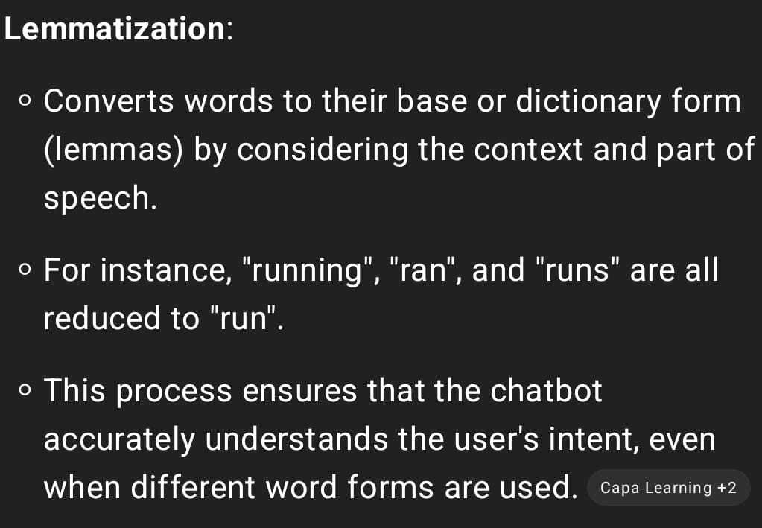

Slide 9
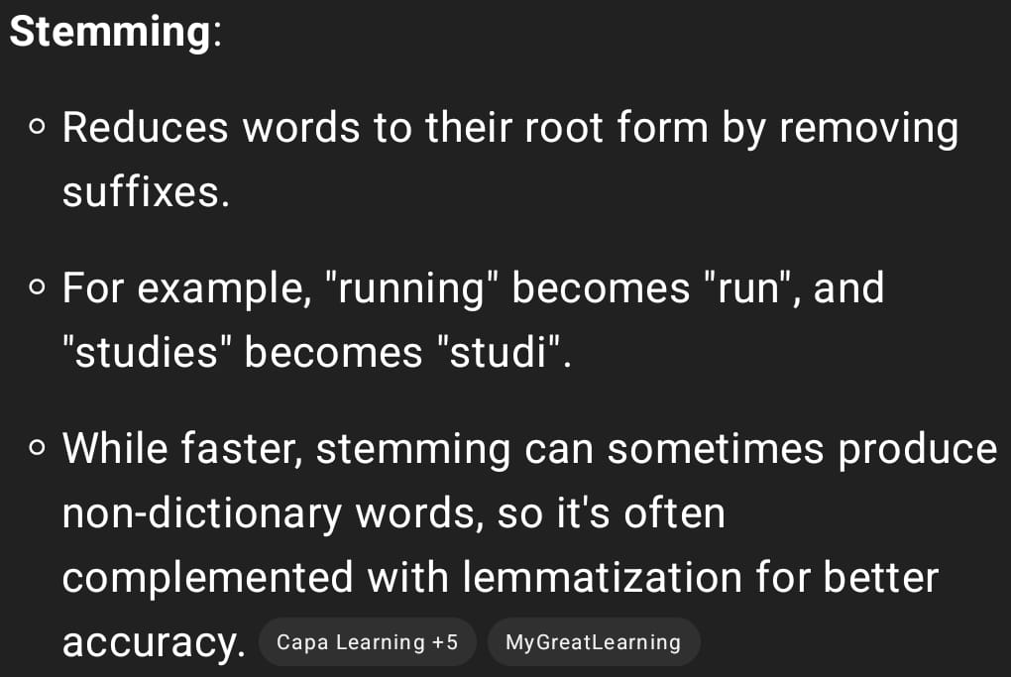

Slide 10
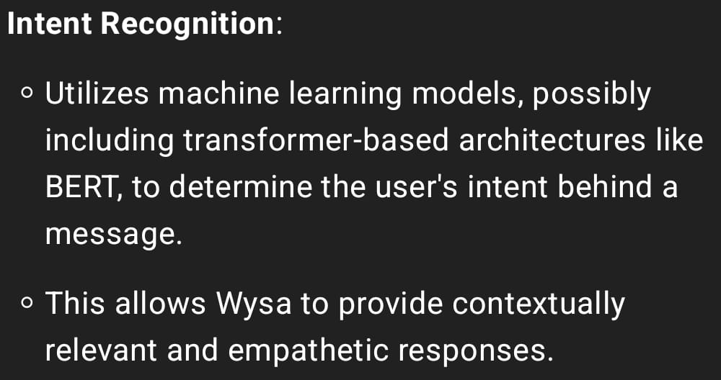

Slide 11
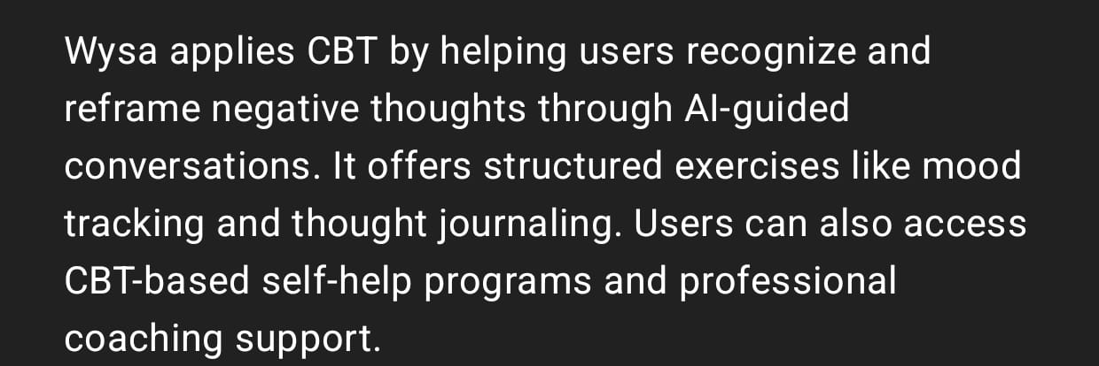

Slide 12
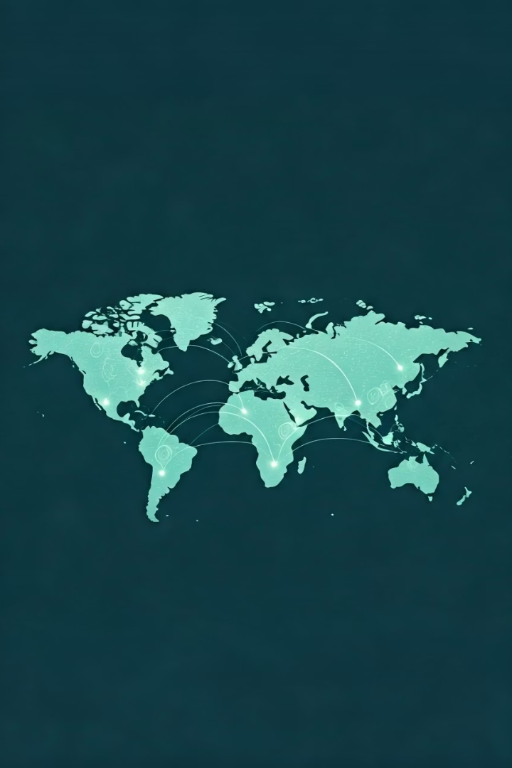
Global Reach, Deep Impact
5M+
3+
92%
Users
Major institutions
Feel better
Across 65+ countries
NHS UK, Accenture, Lufthansa
After just one session
Awards & Recognitions Overview
Google Play Best App 2020: Excellence in app design
ORCHA Best App 2020: Clinician-approved mental health
DigitalHealth.London 2022: Greatest NHS Benefit award
Mozilla Privacy Award 2022: Top privacy practices
Health Tech World 2023: Finalist for Digital Health App
Brandon Hall Group Gold: Employee wellness innovation
Google Assistant Investment: First in Asia
SBRI Healthcare 2023: AI mental health grant
Product Hunt: #4 Product of the Day

Slide 13

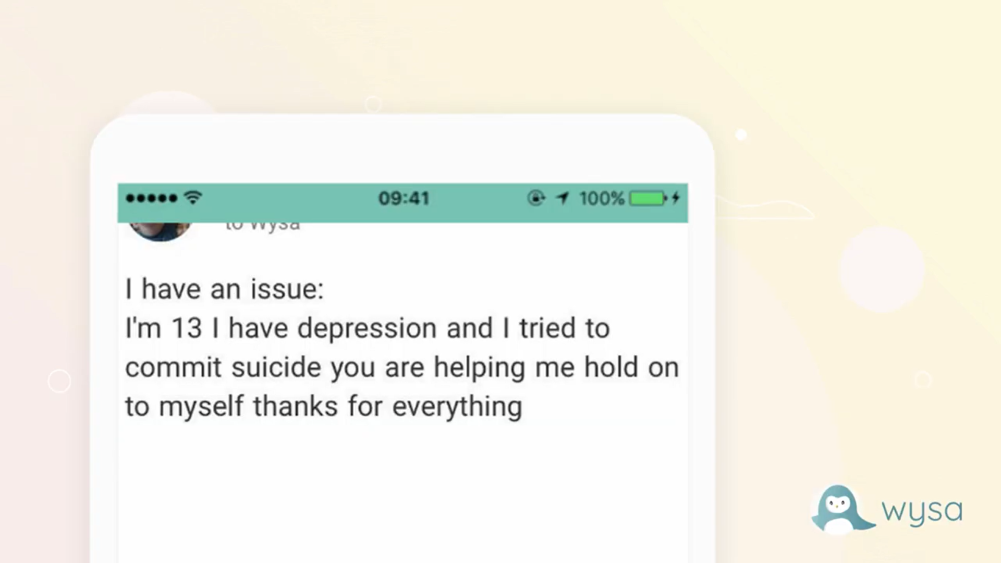
When No One Was There, Wysa Was
Crisis moment
Digital lifeline
13-year-old girl with suicidal thoughts
Wysa provided critical support
Survival story
She later credited Wysa with helping her survive

Slide 14








Trust, Accuracy, and Clinical Strength
Privacy first
Clinical validation
Anonymity & GDPR/HIPAA compliance
Peer-reviewed research
Emotional intelligence
Expert training
Designed for empathetic response
Therapist-trained NLP

Slide 15





Wysa: Lessons and Future Directions
Empathy in AI
AI can be compassionate when designed with care.
Privacy Builds Trust
Anonymity and data safety encourage user confidence.
Bridging Gaps
Technology fills mental health service shortages effectively.
Continuous Improvement
Clinical validation and feedback drive AI evolution.

Slide 16


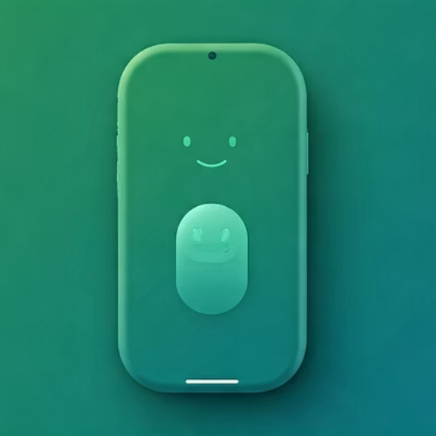
Healing, One Conversation at a Time
Empathy. Technology. Hope.
When AI meets empathy, it becomes a companion - always there, never judging.

Slide 17
REFERENCES :
Meet Our Star Founders:Ramakant from Wysa talks about their AI-led mental health solution for Bharat – YouTube
https://www.youtube.com/watch?v=LjfMqlbMwok&t=2s
https://www.youtube.com/watch?v=BvnfL1wi-e4
https://www.wysa.com/
https://pmc.ncbi.nlm.nih.gov/articles/PMC9897276/
https://www.wysa.com/faq
https://www.youtube.com/watch?v=TDxlpmhLO9I
https://ijip.in/wp-content/uploads/2025/04/18.01.058.20251302.pdf

Slide 18

The little Penguin is here to stay; and it’s to sustain our lives.
THANK YOU
We appreciate your time and attention.
Feel free to ask anything — we’re here to discuss!

